Slide 1
Laptop Price Prediction A Data Science & ML Project
Submitted By
Abhikriti Moti, 12007073

Slide 2

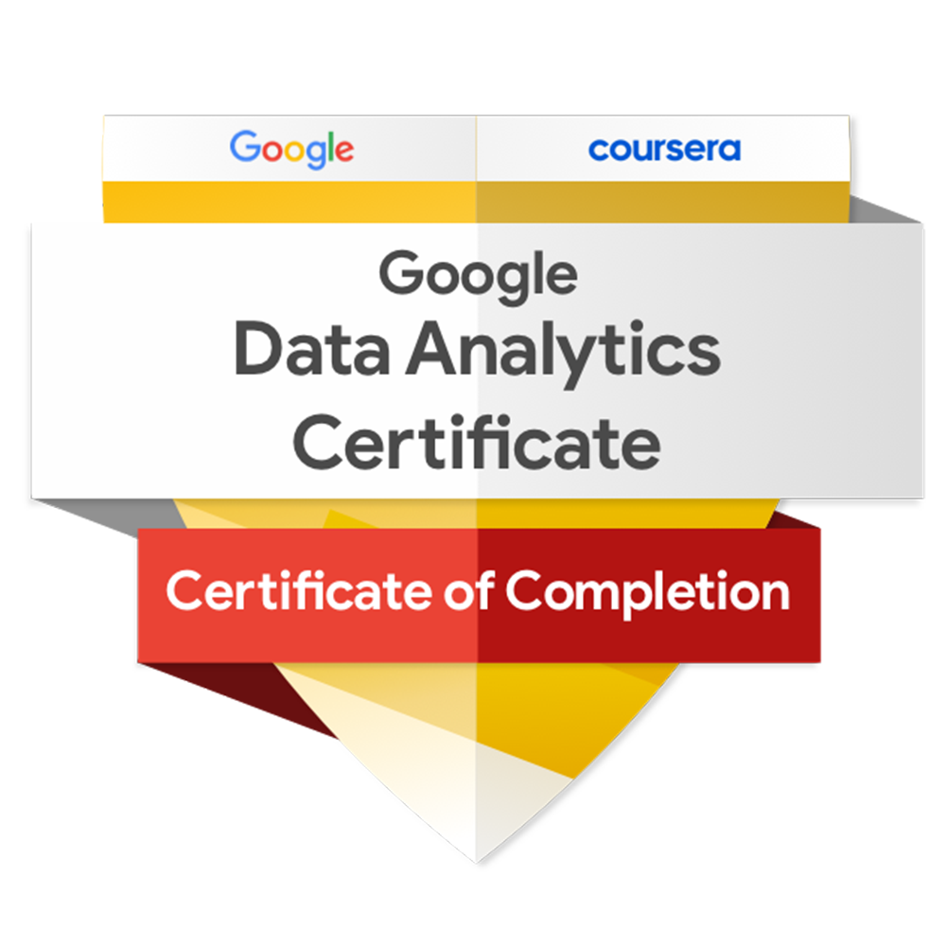

Certification by the ALLSOFT SOLUTIONS – IBM CE
Some Credly Badges Earned during the learning..
Click Here to Verify
Click Here to Verify

Slide 3
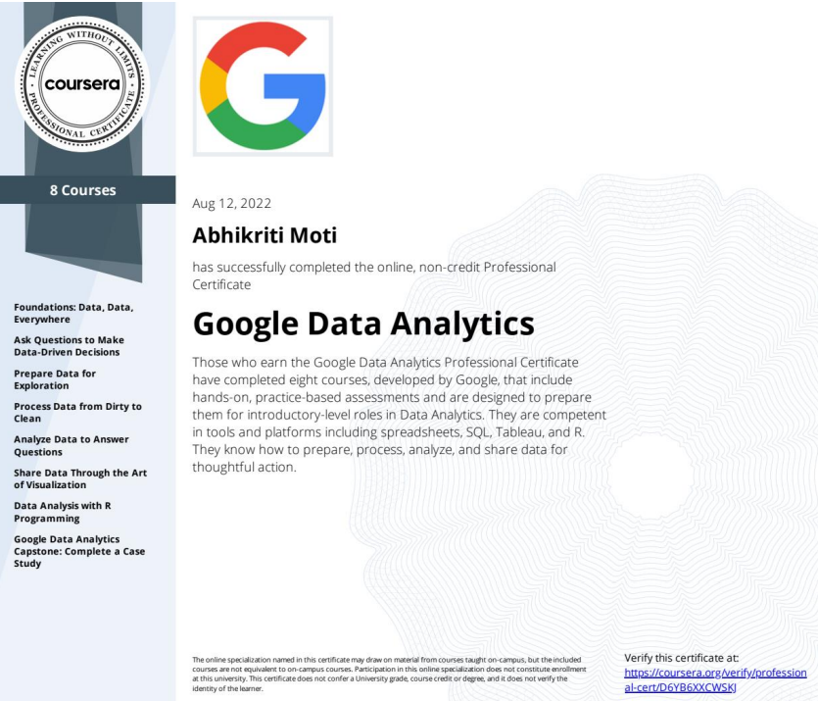
Google Data Analytics Professional Certificate
This additional course was done in continuation with the summer training project.
Verify at https://coursera.org/verify/professional-cert/D6YB6XXCWSKJ

Slide 4
Problem Statement
If any user wants to buy a laptop, then the application should be compatible to provide a tentative price of laptop according to the user configurations.
Data Set is noisy and needs lots of feature engineering, and pre-processing.

Slide 5
Project Lifecycle
Step 01
Step 02
Step 03
Step 04
Step 05
Data Pre-processing
Exploratory Data Analysis
Feature Engineering
Machine learning modeling
Deployment

Slide 6




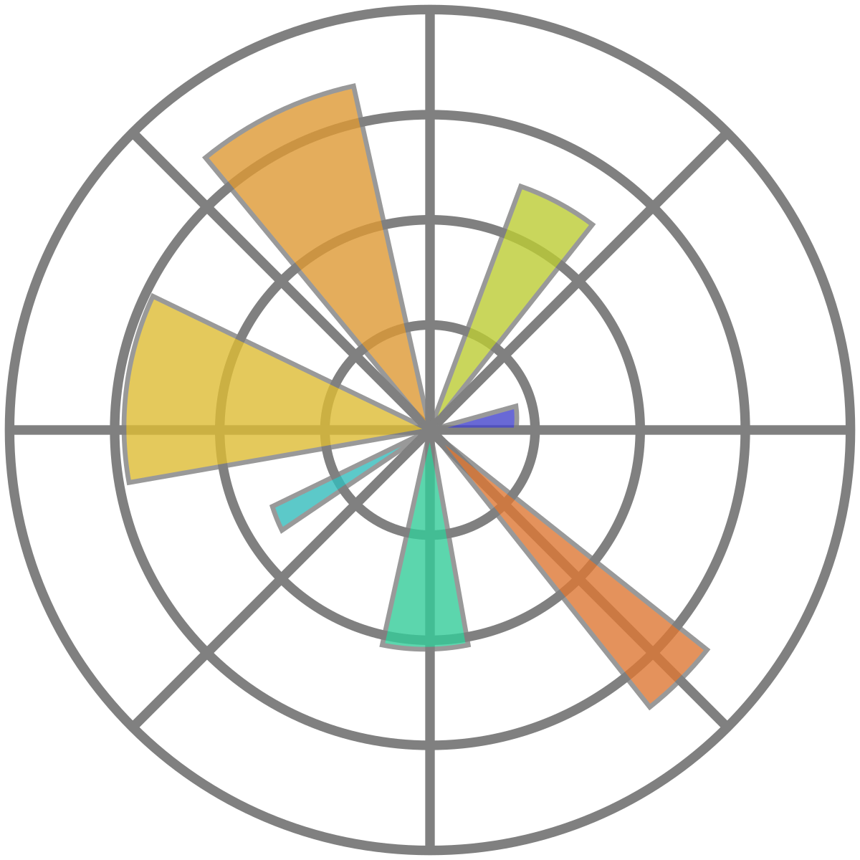
Libraries Used
Streamlit
Numpy
Pandas
Seaborn
Matplotlib
develop web apps and deploy them easily
Fundamental package for scientific computing
High-performance data manipulation
Library is for making Python statistical graphics
Comprehensive library for creating static, animated, and interactive visualizations

Slide 7
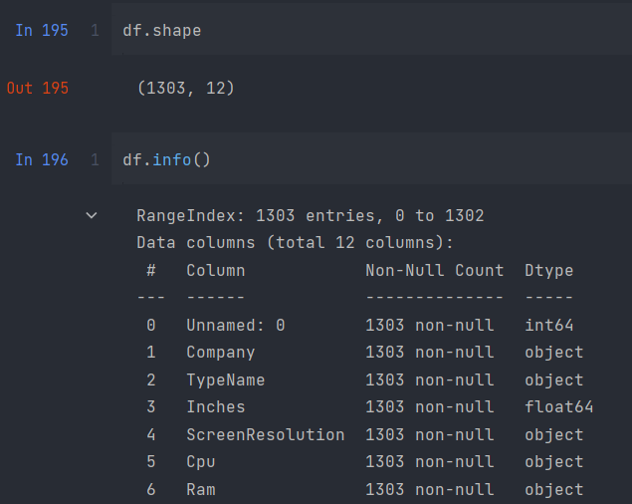
Data Pre-processing Steps
Download the dataset from Kaggle:
https://www.kaggle.com/code/danielbethell/laptop-prices-prediction/data
1. Data quality assessment
Idea of its overall quality, relevance to project, and consistency.

Slide 8



2. Data cleaning and Transformation
Remove data that does not belong in your dataset.
Converting data from one format or structure into another.

Slide 9
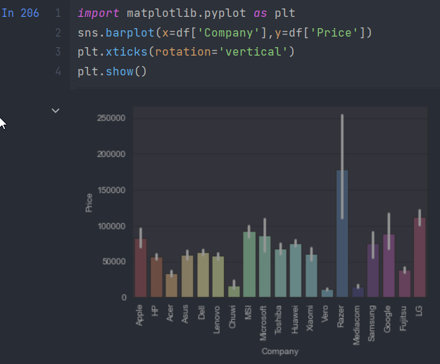
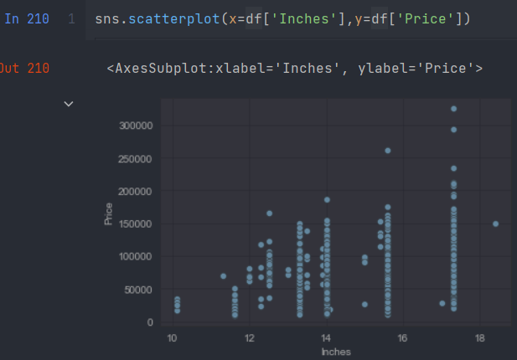
Exploratory Data Analysis
Initial investigations on data to discover patterns, spot anomalies, test hypothesis and check assumptions

Slide 10
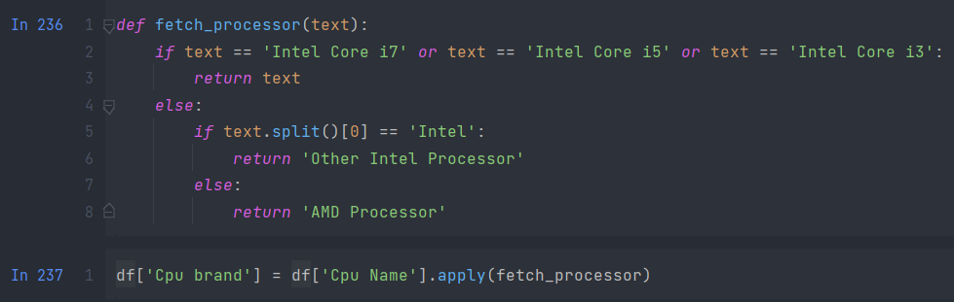
Feature Engineering
Leverages data to create new variables
Extracting relevant features from the data to train ML algorithms

Slide 11
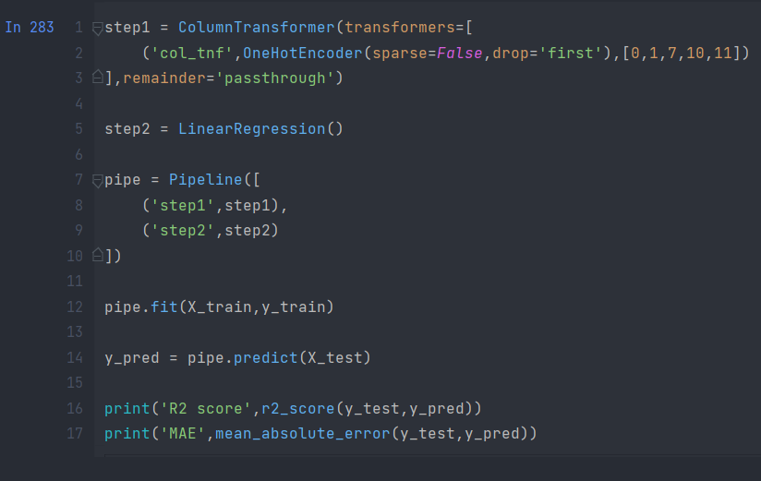
Machine learning modeling
Linear Regression
Linear regression algorithm shows a linear relationship between a dependent (y) and one or more independent (y) variables.
Finds how the value of the dependent variable is changing according to the value of the independent variable.

Slide 12
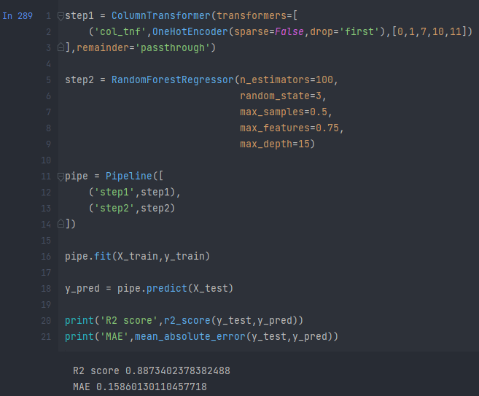
Random Forest
Contains a number of decision trees on various subsets of the given dataset and takes the average to improve the predictive accuracy of that dataset.
It predicts output with high accuracy, even for the large dataset it runs efficiently.

Slide 13
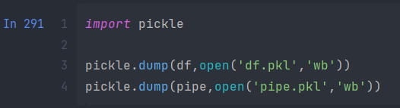
Exporting the Model
Save the pipeline object for the development of the project website
Save the ML model using pickel

Slide 14

Creating a Web Application
Use streamlit to create a web app
create a file named main.py in the same working directory where we will write code for streamlit.
Import the model

Slide 15
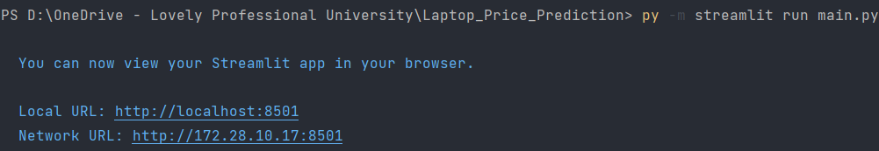
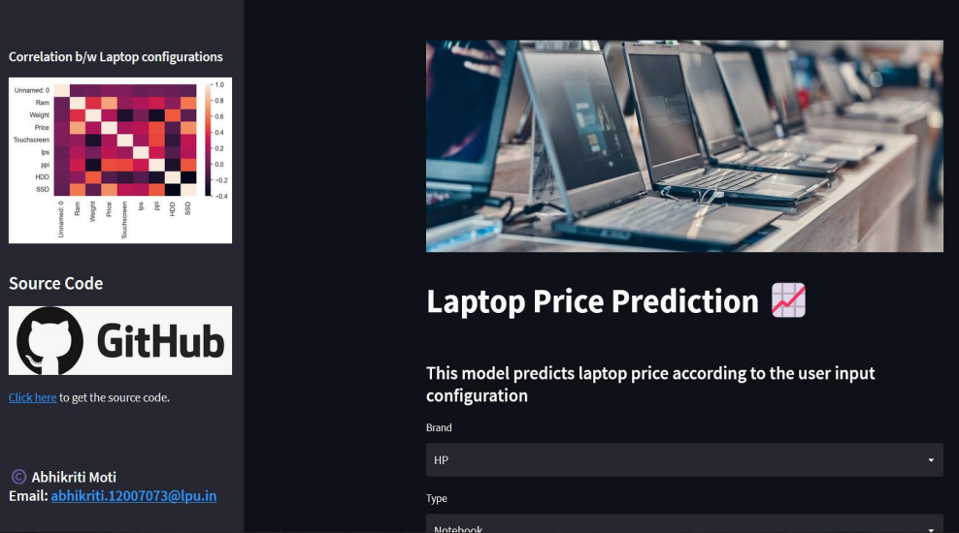
Run the app file using the below command

Slide 16

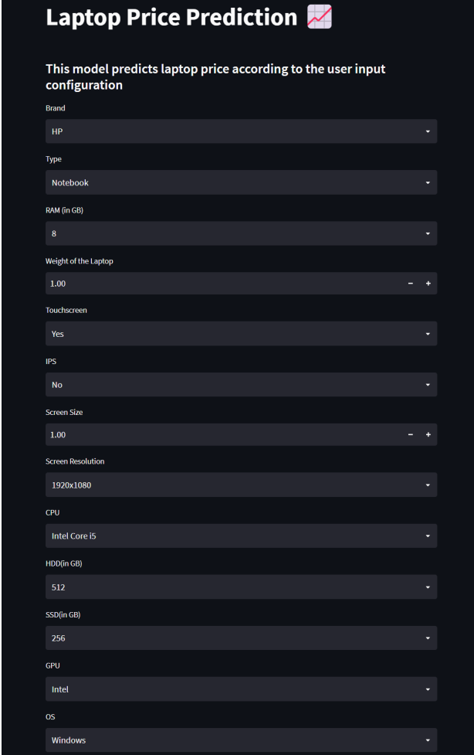
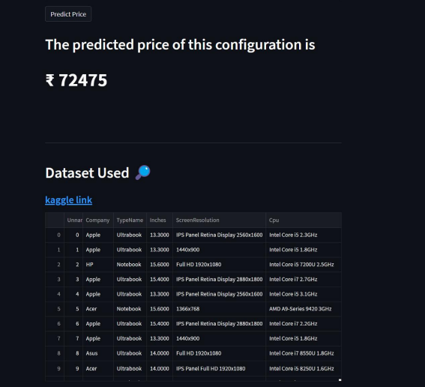


Slide 17
Learning Outcomes
Save Demonstrate proficiency with statistical analysis of data.
Develop the ability to build and assess data-based models.
Investigate data and designs by loading, extracting, transforming, and analyzing data from various sources.
Implement histograms, classifiers, decision trees, sampling, linear regression, and projectiles in a scripting language.

Slide 18
Thanks!
Do you have any questions?
abhikritimoti@outlook.com

